Slide 1


COVID-19 In Maryland
8 DEC 2020
Rohini Salla
UMBC Fall 2020
Professor Isaac Mativo
HIT 750 : Data Analytics
Notes:
Eric

Slide 2

Outline
Background knowledge,
Problem statement,
Identification of datasets,
Statistical methods applied,
Results, and
Discussion.
This Photo by Unknown Author is licensed under CC BY-SA
Notes:
Eric

Slide 3

Background Knowledge
What is COVID-19?
Spread
Response
Economy and Autonomy vs Public Safety
Ongoing strategy and debate
Notes:
Eric

Slide 4
Related Work
Masks
How effective are they?
Are they being worn correctly?
Social Distancing, “6 foot” rule
Rates of COVID-19 in other states/countries
Notes:
Eric

Slide 5

Problem Statement
The goal of our data analysis is to determine the efficacy of government mandates/restrictions to combat the spread of COVID-19 in Maryland.
Null Hypothesis-lockdown measures mandated in Maryland had no significant impact on the spread or number of COVID-19 cases witnessed
Alternative Hypothesis-lockdown measures mandated in Maryland had a significant impact on the spread or number of COVID-19 cases witnessed
Notes:
Eric

Slide 6


Data Source and Relevance to the Study
The data used in this study came from a COVID Tracking Project, which is a volunteer organization launched from The Atlantic and dedicated to collecting and publishing data tracking COVID-19 outbreak throughout the United States.
Most of the data compiled were taken directly from the websites of local or state/territory public health authorities.
The website contains data from March 14 to date.
For the purpose of this study, we limited our scope to Maryland, by examining reported data from March 14 through October 20.
Notes:
Zenas

Slide 7
Data Information
The dataset contained the following columns:
date, state, positive, positive Increase, positive Cases Viral, negative, negative Tests Viral, pending, positive Tests Viral, totalTest People Viral, totalTest Viral, totalTestEncountersViral, negative Tests People Antibody, negative Tests Antibody, positive Tests People Antibody, positive Tests Antibody, positive Tests People Antigen, positive Test Antigen, totalTest People Antigen, totalTest Antigen, hospitalized Cumulative, inIcuCumulative, on Ventilator Cumulative, hospitalized Increase, death, death Confirmed, deathProbble, deathIncrease, recovered, data Quality Grade.
(See appendix B).
Source: https://covidtracking.com/data/download
Notes:
Zenas

Slide 8
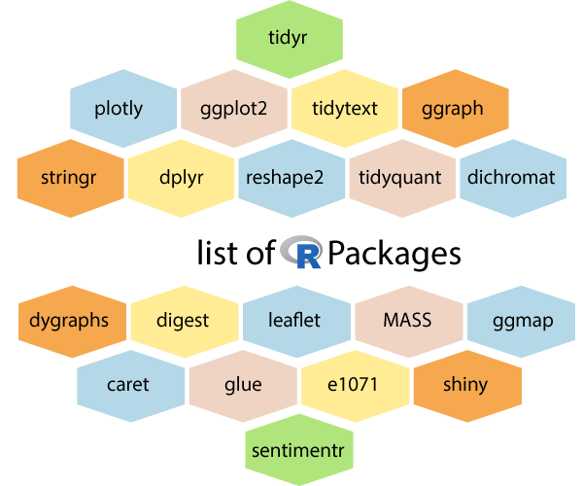
Tool Used
Data Wrangling(Cleansing, Preparation)
We considered only certain variables that were found important after performing some basic data wrangling (cleansing) as seen in the results.
IDE Used
We used R-Studio (Version 1.3.1073) as the integrated development environment for statistical computation, analysis and, visualization of our data.
Packages(Library) Used
readxl, ggplot2, dplyr, tidyr, data.table, gridExtra, grid,
Notes:
Zenas:

Slide 9
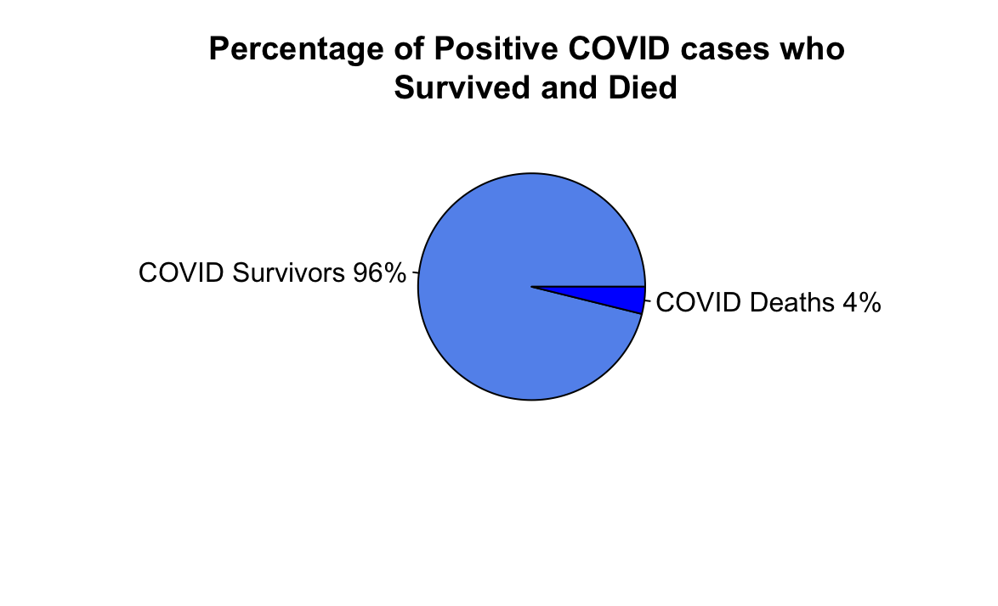
Notes:
Zenas

Slide 10
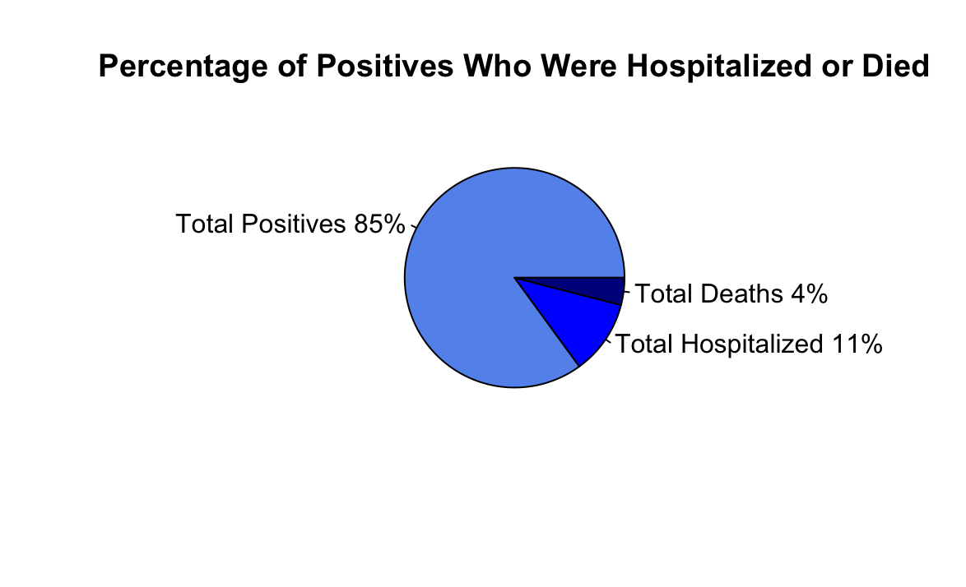
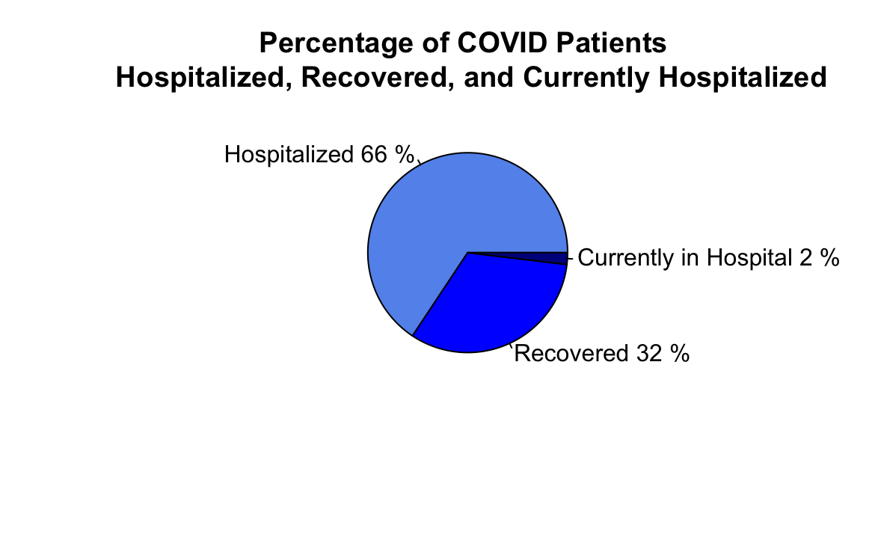
Notes:
Zenas

Slide 11
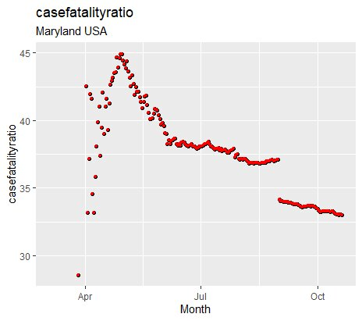
Case fatality ratio (CFR) =
(Number of deaths from disease/(Number of deaths from disease + Number of recovered from disease))*100
Notes:
Zenas

Slide 12
Statistical Methods Applied
Statistical models are important techniques for evaluating infectious disease data analyses in real time.
Reference model: stratified sampling.
This method allowed us to divide the total population-data into smaller groups or strata( months and mandated dates in this case) for better understanding.
By using a stratified method, we were able to clearly see the timeline of restrictions and mandates, and if the imposed mandates had an impact on the spread of COVID-19 in Maryland.
Grouping the data into various months, made it convenient to manage given that our data set was incremental on a monthly basis and could be best model using ANOVA statistical model, more specifically one-way.
Notes:
Zenas
Instead of doing a time series analysis or event study analysis but instead we decided to refer to the stratified sampling model instead we categorized time by month.
After we categorized into months we plotted regression lines to see if months had different trends. As mandates are enforced they change the trend of the month. Finally settled on one-way analysis of variance (ANOVA)

Slide 13
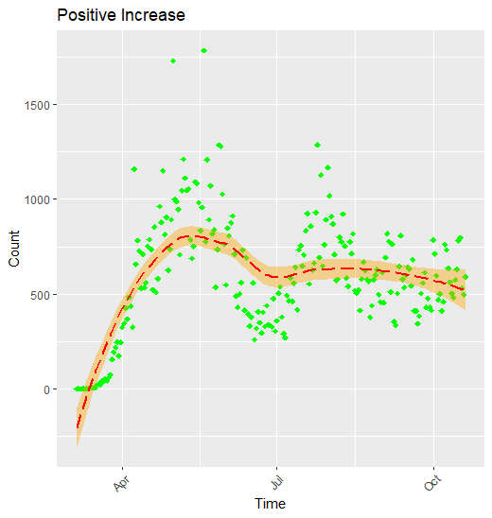
Scatterplot with Regression line - positiveincrease
Notes:
Rohini

Slide 14
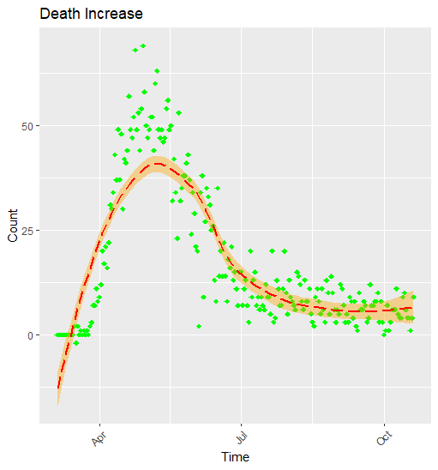
Scatterplot with Regression line - deathincrease
Notes:
Rohini

Slide 15
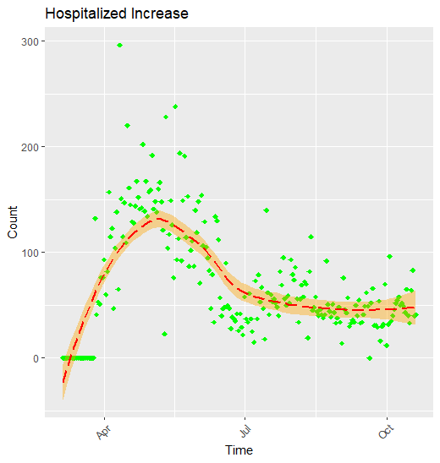
Scatterplot with Regression line - hospitalizedincrease
Notes:
Rohini

Slide 16
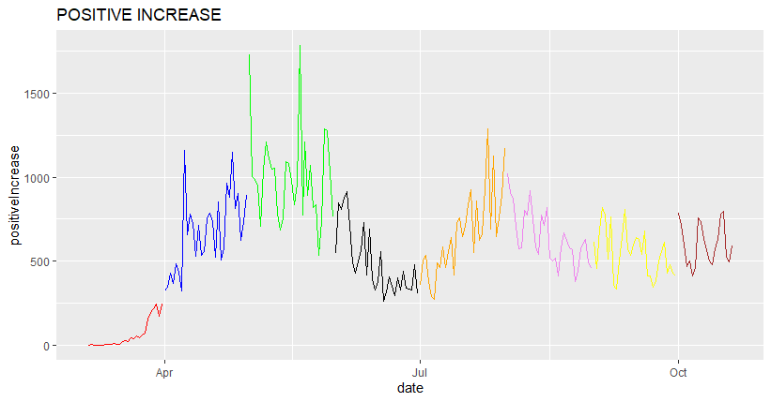
Line graph showing positive increase of each month
Notes:
Rohini

Slide 17
5 March 2020: Hogan declares a state of emergency; first 3 confirmed positive cases
30 March 2020: Governor issues stay-home order
15 April 2020: Hogan signs face-mask order
13 May 2020 : Hogan announces Stage One of reopening
29 July 2020: Hogan expands mask order, issues out-of-state travel advisory
28 August 2020: All schools authorized to reopen
1 September 2020: Maryland ready to enter into Stage Three of recovery plan
21 September 2020:The governor announced restaurants can expand indoor capacity from 50% to 75% beginning at 5 p.m.
Period1 - 5 March 2020 to 30 March 2020
Period2 - 30 March 2020 to 13 May 2020
Period3 - 13 May 2020 to 29 July 2020
Period4 - 29 July 2020 to 1 September 2020
Period5 - 1 September 2020 to 21 September 2020
Notes:
Rohini

Slide 18
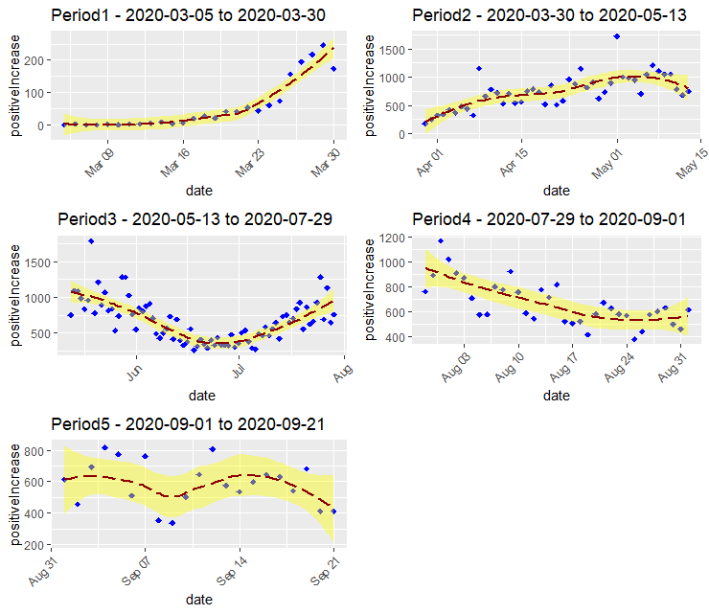
Grid chart showing scatterplots with regression line for Period1, Period2, Period3, Period4, and Period5
Notes:
Rohini

Slide 19
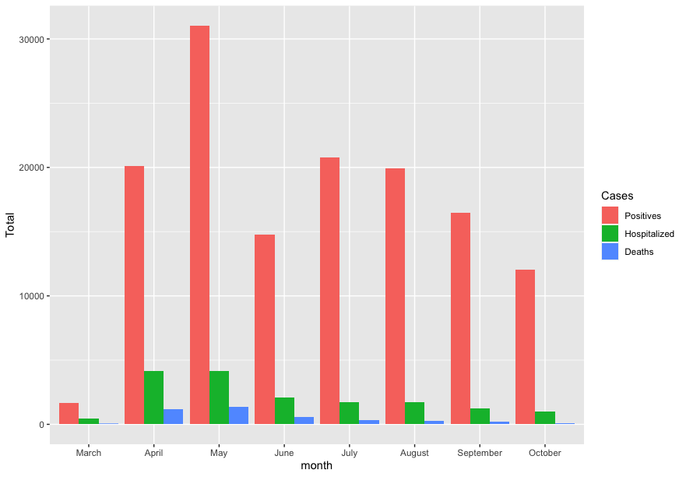
Grouped Bar Chart:
Sum Total of
Positive Cases, Hospitalizations, and Deaths
By Month
April 15: Face Mask Order
May 13: Reopening Begins
August 28 Schools Reopen
Notes:
Hala 1
Barcharts to get a sense of the difference between months before we compared groups
We decided to focus on positive cases instead of hosp and deaths

Slide 20
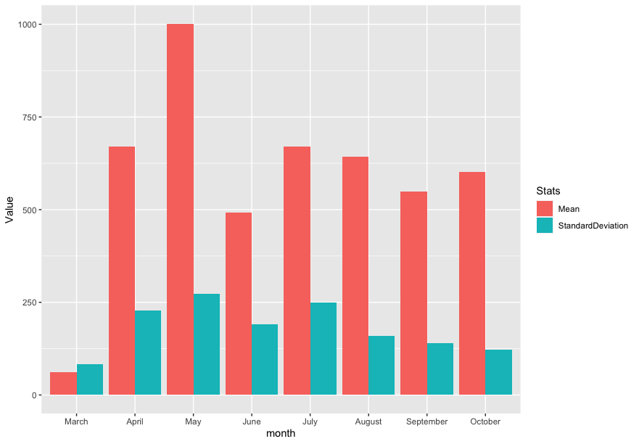
Grouped Bar Chart:
Mean and Standard Deviation of Positive Cases
By Month
April 15: Face Mask Order
May 13: Reopening Begins
August 28 Schools Reopen
Notes:
Hala 2
Positive Cases are more indicative of mask mandate. Looked at mean and SD.

Slide 21
One-Way Anova and
Post-Hoc Test
Timeline and Mandates | Month Comparison | P-value
March 3: State of Emergency March 16: Schools Close March 23: Nonessential Business Close | March-April | 0.0000000
April 15: Face Mask Order | April-May | 0.0000000
May 13: Businesses Reopen | May-June | 0.0000000
 | June-July | 0.0104391
 | July-August | 0.9991194
August 27: Schools Reopen | August-September | 0.5798739
September: Stage 3 Reopening | September-October | 0.9839012
Notes:
Hala 3

Slide 22
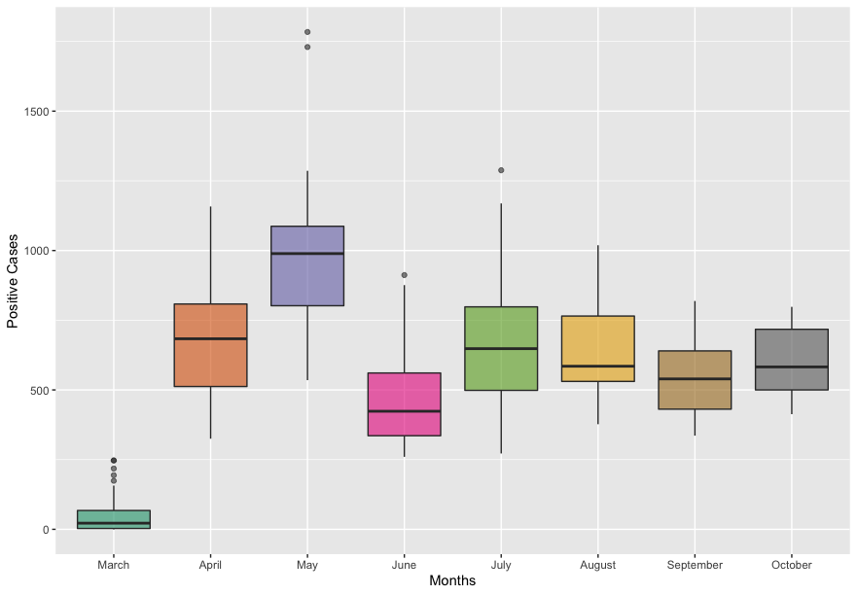
BoxPlot:
Positive Cases by Month
Notes:
Hala 4
From the Anova Test we know that May is statistically significant from all other months. The drop in June is statistically different from all other months but not compared to sept and oct.

Slide 23

Discussion
Many factors impact positive case, hospitalization, and death rates.
Mask mandates are part of a multi-faceted tool to managing the rise of COVID-19
Natural data over time has limitations
Guinea-Bissau Randomized Control Study
Challenges were a learning experience
This Photo by Unknown Author is licensed under CC BY-NC-ND
Notes:
Hala 5

Slide 24
References
Hypothesis Testing - Examples and Case Studies. (n.d.). https://www2.stat.duke.edu/courses/Fall11/sta10/STA10lecture21.pdf
Coronavirus disease 2019. (2020, March 3). Wikipedia. https://en.wikipedia.org/wiki/Coronavirus_disease_2019‌
CDC. (2020, August 7). Coronavirus Disease 2019 (COVID-19). Centers for Disease Control and Prevention. https://www.cdc.gov/coronavirus/2019-ncov/prevent-getting-sick/cloth-face-cover-guidance.html
Dr. Fauci Sets the Record Straight About Masks. (n.d.). Www.Msn.Com. Retrieved October 27, 2020, from https://www.msn.com/en-us/health/medical/dr-fauci-sets-the-record-straight-about-masks/ar-BB19Aof3
Estimating mortality from COVID-19. (n.d.). Www.Who.Int. https://www.who.int/news-room/commentaries/detail/estimating-mortality-from-covid-19
R code: https://drive.google.com/file/d/1dBlVdtu9VjNNRraaqOAZqDhLudUhu76q/view?usp=sharing
Dataset: https://drive.google.com/file/d/1hIfuWDDOr4QD3QrZDdR6RGmWD8mFuU8M/view?usp=sharing

